Slide 1
Model Learning

Slide 2
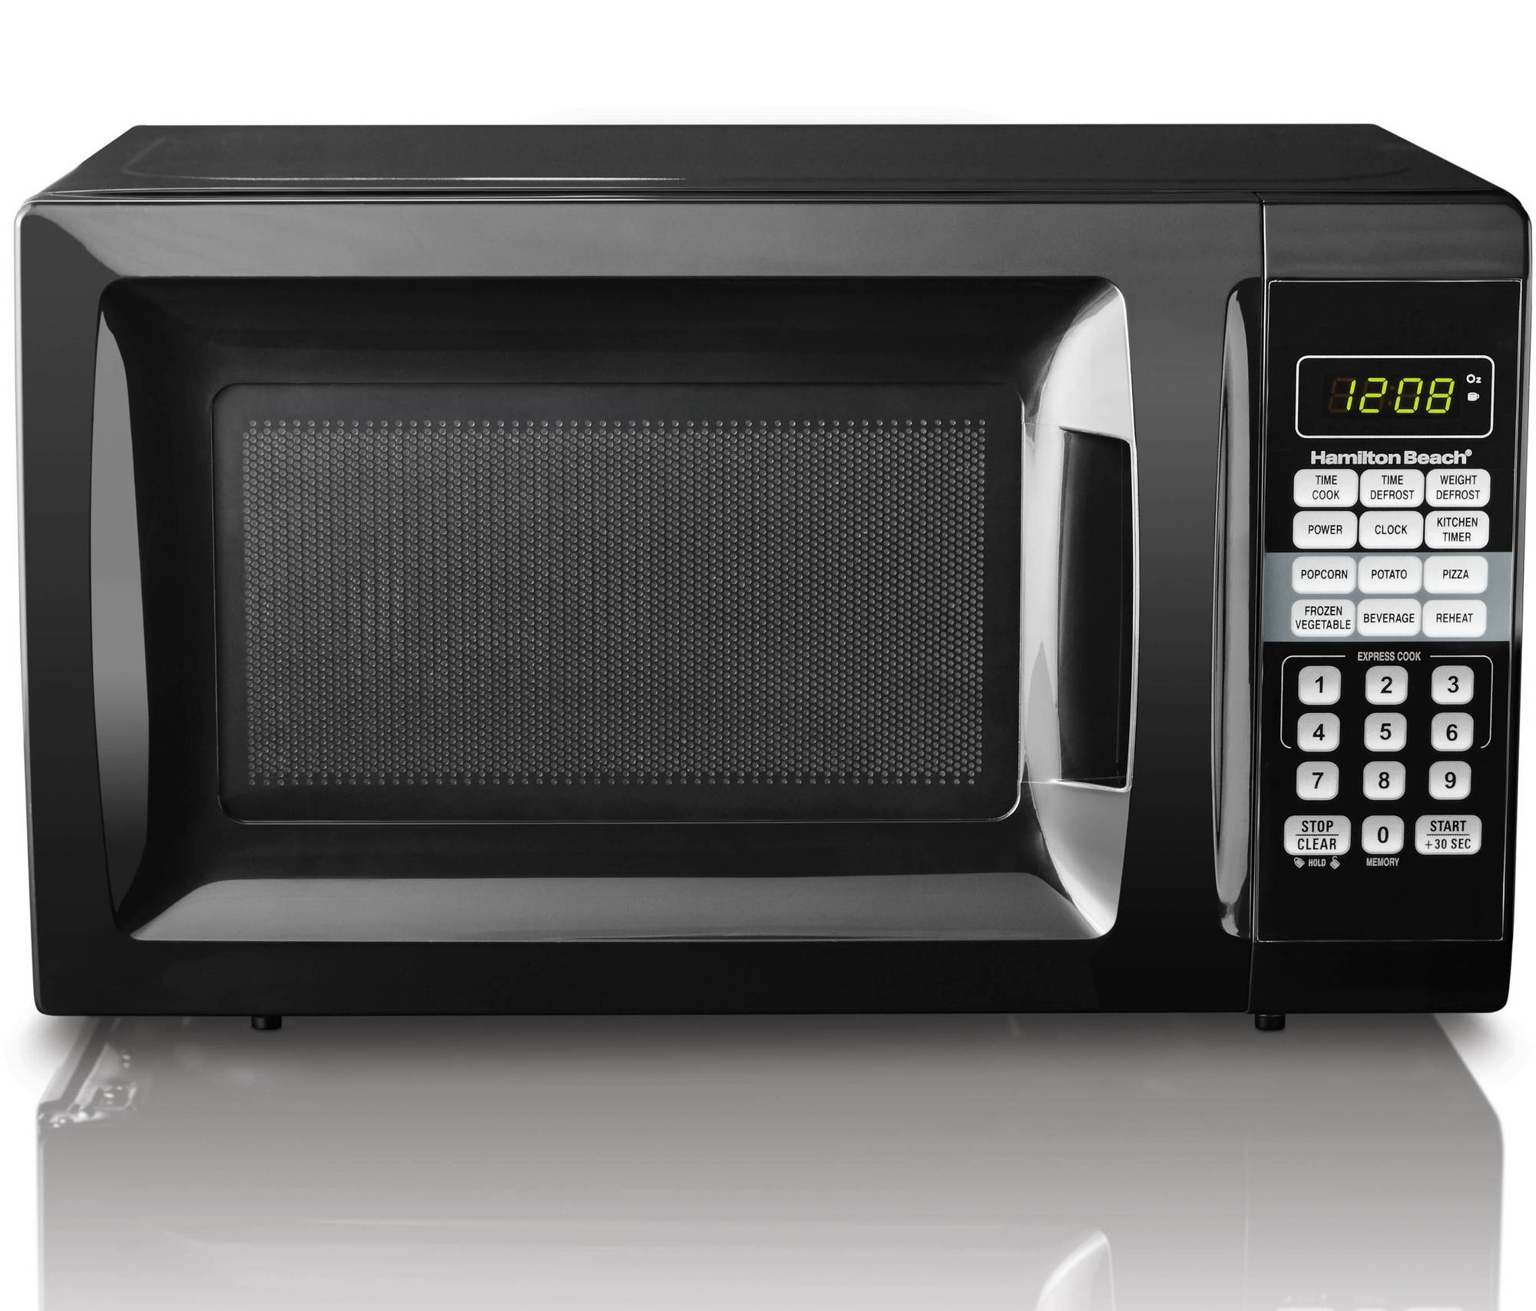
Notes:
Routinely manage to learn the behavior of a device or a computer program by just pressing buttons and observing the resulting behavior.
-> mental model/state diagram is created of device
->experiments lead to determination of the global states of the device, and which transitions and outputs occur in response to which inputs.
SUT
Black microwave -> black box
This presentation reviews an article that implements the state machine learning algorithm automatically.

Slide 3
Outline
Model of a Model
L-STAR
Biometric Passport
Abstraction
Results + Validation
Conclusion
Vaandrager, Frits. "Model Learning.“
Communications of the ACM 60.2 (2017): 86-95.
Aarts, Fides, Julien Schmaltz, and Frits Vaandrager. "Inference and abstraction of the biometric passport." Leveraging Applications of Formal Methods, Verification, and Validation (2010): 673-686.

Slide 4
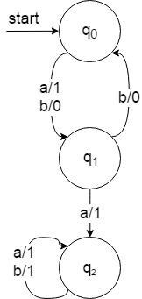




Model of a Model
Mealy machine

Slide 5
L-STAR
Minimally Adequate Teacher
H
M
learner
teacher
Membership Query
Equivalence Query

Slide 6
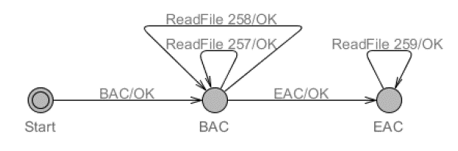


Biometric Passport
What’s in it?
BAC
Machine Readable Zone data #257
i.e.: name, date of birth, nationality
Facial Image #258
Biometric data #259
i.e.: fingerprints, iris scan
EAC

Slide 7

Abstraction Mapping
$\left|I\right|→ ∞$
Transducer classes:
$ValidAfterBAC →\{257, 258\}$
$ValidAfterEAC →\{259\}$
$NotValid→\left\{i ∈ℕ \right|i \text{∉} \{257,258,259\}\}$
Less states, less transitions, less inferring time
Notes:
Input readfile integer. Readfile 500

Slide 8
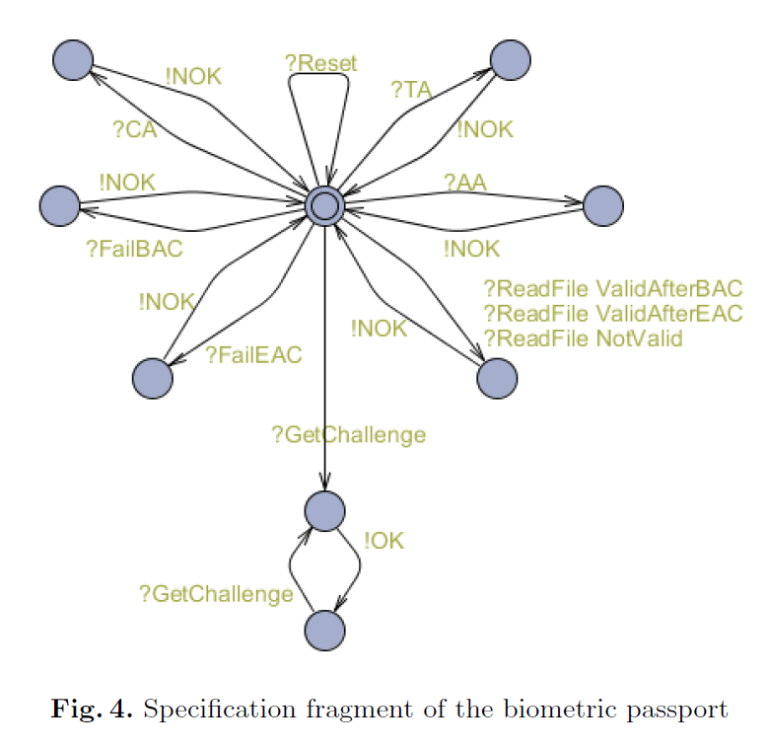
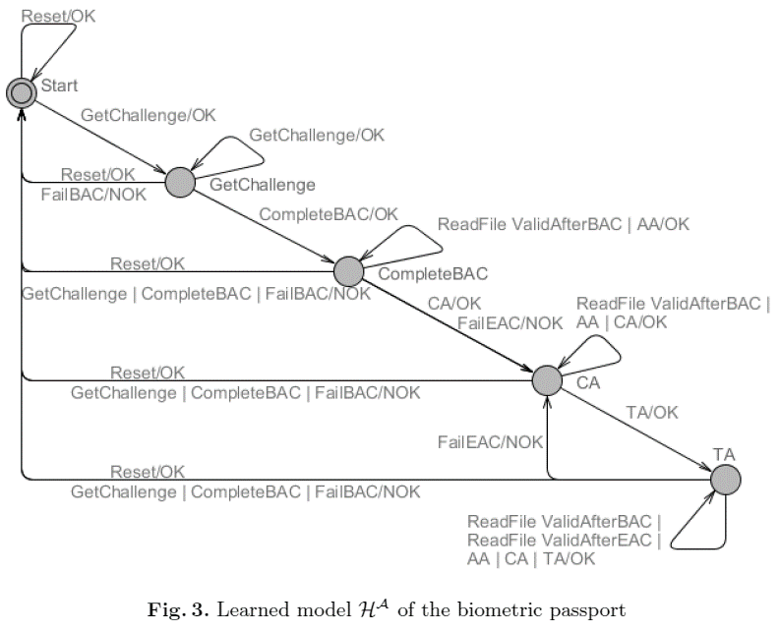
Results and Validation

Slide 9


Results and Validation
observation
equivalent
Hª
$$≅$$
Mª
transducer
observation
equivalent
H
$$≅$$
M
Notes:
From Ha to H:
Replace ValidAfterBAC in Ha by two transitions same source and target but with labels ReadFile(257) and readFile(258).
Replace ValidAfterEAC by an identical transition with label ReadFile(259)
Replace NotValid by transitions ReadFile(256). ReadFile(260)….
If M treats equivalent input symbols in an equivalent way, observation equivalence Ma and Ha, implies observation equivalence of M and H
-> Structural assumptions anout the behavior of the biometric passport, the abstraction does not lead to a loss of information.
Theorem 1
Call two input enabled actions i1, i2 of Mealy machine M equivalent, notation i1 =i2, if they are mapped to the same abstract action. Suppose that in M equivalent inputs induce identical outputs and equivalent successor states:
Then Ma ~~Ha implies M~~H.

Slide 10
Conclusion
Transducing can successfully be used
Yet another case study
Time speedup

Slide 11
End

